Slide 1

FutureYou
Where "I don't know what I want to be" turns into "Here's my next step" — AI-powered.
The Team: Group #3
Tobi Onanuga
Radhika Satapathy
Pavana Ramagiri
Parthi Elangovan

Slide 2



Personalized Guidance at Scale
FutureYou is an AI-powered career mentor designed to transform career confusion into clarity by helping students translate academic interests into real-world career paths.
MISSION: To Democratize Access
Our mission is to democratize access to personalized career guidance for every student, not just the privileged few.
VISION: AI Mentorship
Our vision is a world where every young person has an AI mentor guiding their path with confidence, curiosity, and purpose.

Slide 3

The Problem: A Crisis of Direction & Cost
Students face life's biggest decision — choosing a college major — before exploring the real world of work. One counselor serves 408 students on average, using fifty-year-old guidance methods.
73%
50%
$9B
Change Majors
Regret Degree
Lost Productivity
Students switch paths after starting
Half wish they'd chosen differently
Economic cost of career misalignment
"I like science... but what can I do with it?"

Slide 4



User Personas
FutureYou connects multiple user personas on one platform, creating a living bridge between curiosity, opportunity, and real-world connection.
Maya - The Explorer
James - The Re-thinker
Alex - The Pivoter
High-school junior who loves learning but has no idea how it connects to real careers. Wants honest, reliable guidance — not guesswork.
College student re-thinking his major before more tuition bills pile up. Needs clarity before making costly mistakes.
Early-career professional ready to pivot — searching for a new direction without starting over completely.
Beyond students, FutureYou serves mentors (to give back), recruiters (to find early talent), and educators (for data-driven support).

Slide 5






FutureYou: Solution
AI Mentor
Career Engine
Personalized, conversational guidance tailored to individual student needs and aspirations.
Analyzes skills, interests, and market trends to suggest relevant career paths.
Future-You Simulator
Action Plans
Visualize potential career paths and their impact on future life scenarios.
Step-by-step roadmaps for course selection, skill development, and experiential learning.
Responsible AI
Secure & Private
Ethical guidelines and transparent algorithms ensure fair and unbiased recommendations.
Robust data protection for sensitive student information.
Continuous Learning
AI models constantly improve with new data, refining accuracy and relevance

Slide 6
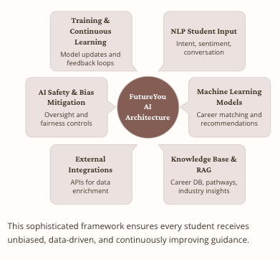
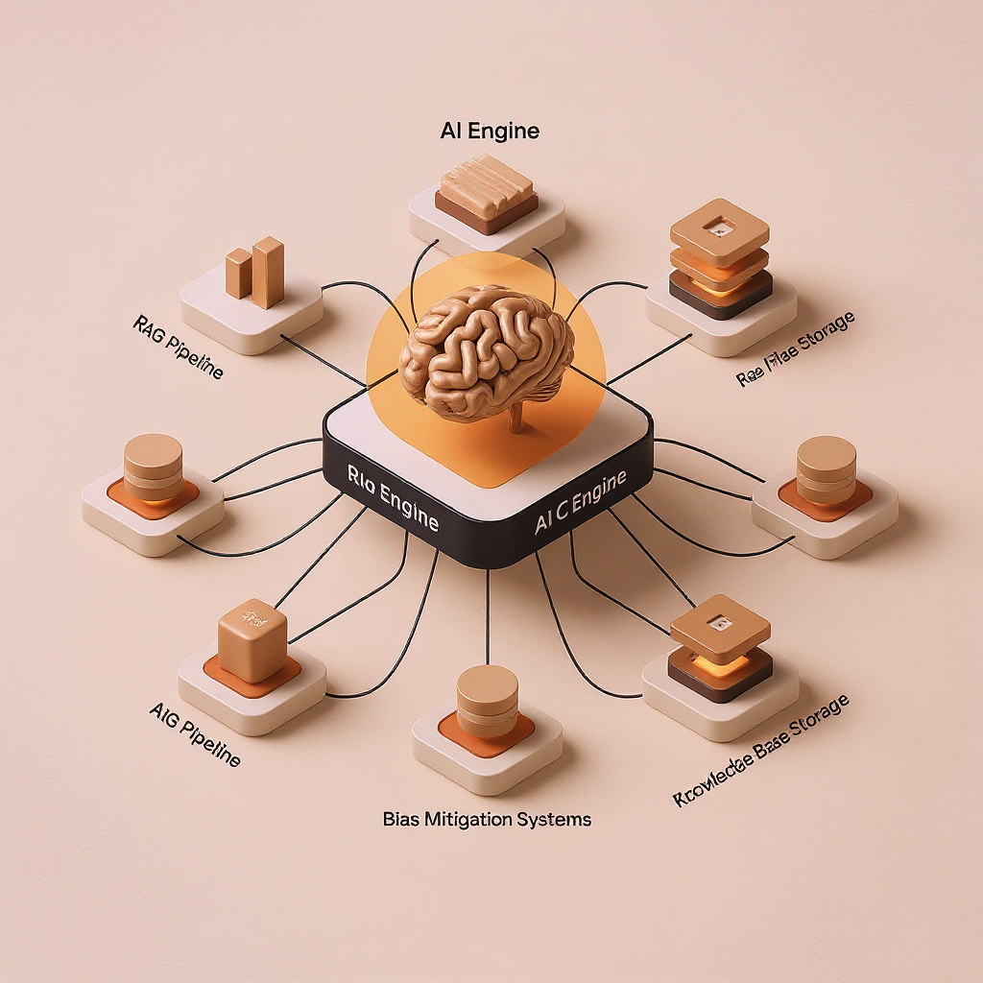
FutureYou: Solution Architecture

Slide 7
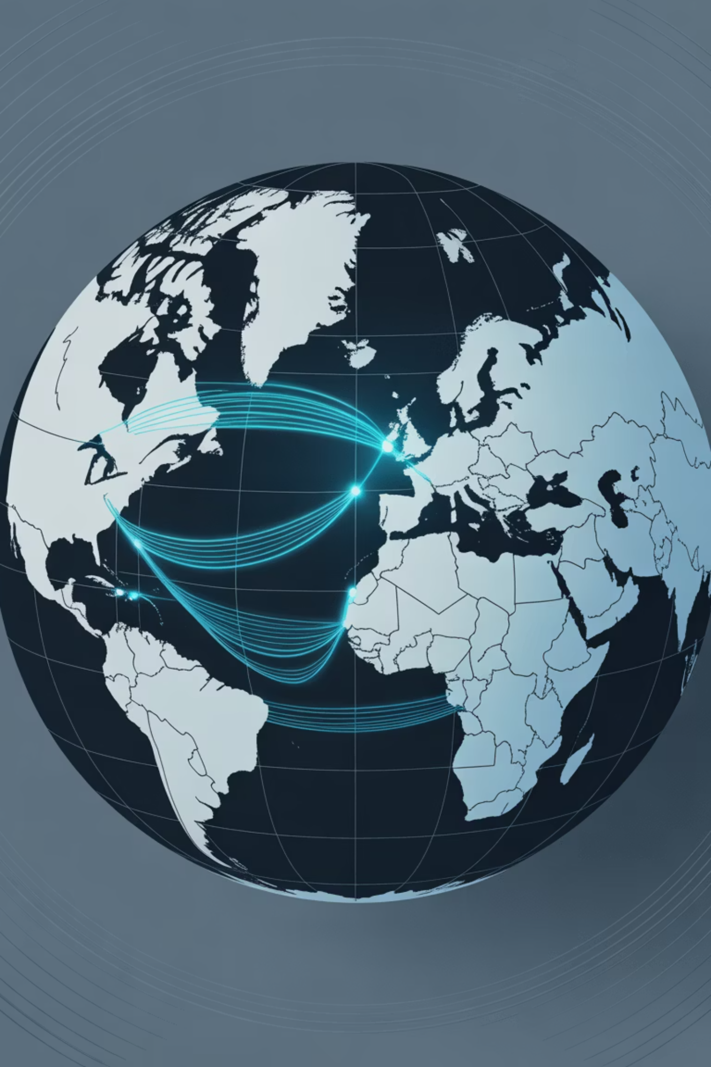
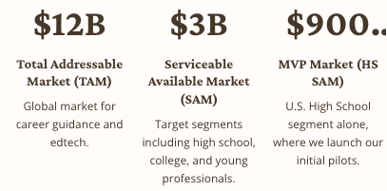

Market Opportunity
We are targeting a massive, underserved globally market hungry for accessible, high quality career guidance. Our initial focus in the US high-school segment
TAM $12B | SAM $3B | HS SAM $900M
Our MVP launches in 10 pilot schools, reaching 10,000 students, proving engagement and conversion before scaling to colleges and young professionals across the U.S., India, Europe, and East Asia.
Massive unmet demand for accessible, personalized career guidance at scale.

Slide 8

Go-to-Market Strategy: Acquire, Engage, Retain
Our scalable growth model features a tiered pricing structure that captures value at every life milestone and is designed for viral adoption.
1
Acquire
Free access hooks users early.
School partnerships and counselor evangelism.
Viral TikTok and Instagram campaigns.
2
Engage
Gamified discovery challenges and badges.
Shareable progress dashboards and planning tools.
$4.99/mo Plus Tier converts most engaged users.
3
Retain
Multi-year planning and smart nudges.
Milestone celebrations and mentor connections.
$9.99/$19.99 tiers for college/career pivoters.
This low-cost, high-impact model ensures strong retention and exponential Lifetime Value (LTV).

Slide 9
Key Metrics for Success and Model Validation
We will measure success across core business growth and the performance of our underlying AI model, ensuring both financial and educational impact.
Business Success Targets
Model Accuracy & Impact
12%
90%
Conversion Rate
Intent Accuracy
Target for free-to-paid user conversion.
Precision in understanding casual student language.
70
85%
Net Promoter Score (NPS)
Recommendation Quality
A measure of user loyalty and advocacy.
Satisfaction with personalized career recommendations.
85%+
User Satisfaction
Overall satisfaction with the platform experience.

Slide 10
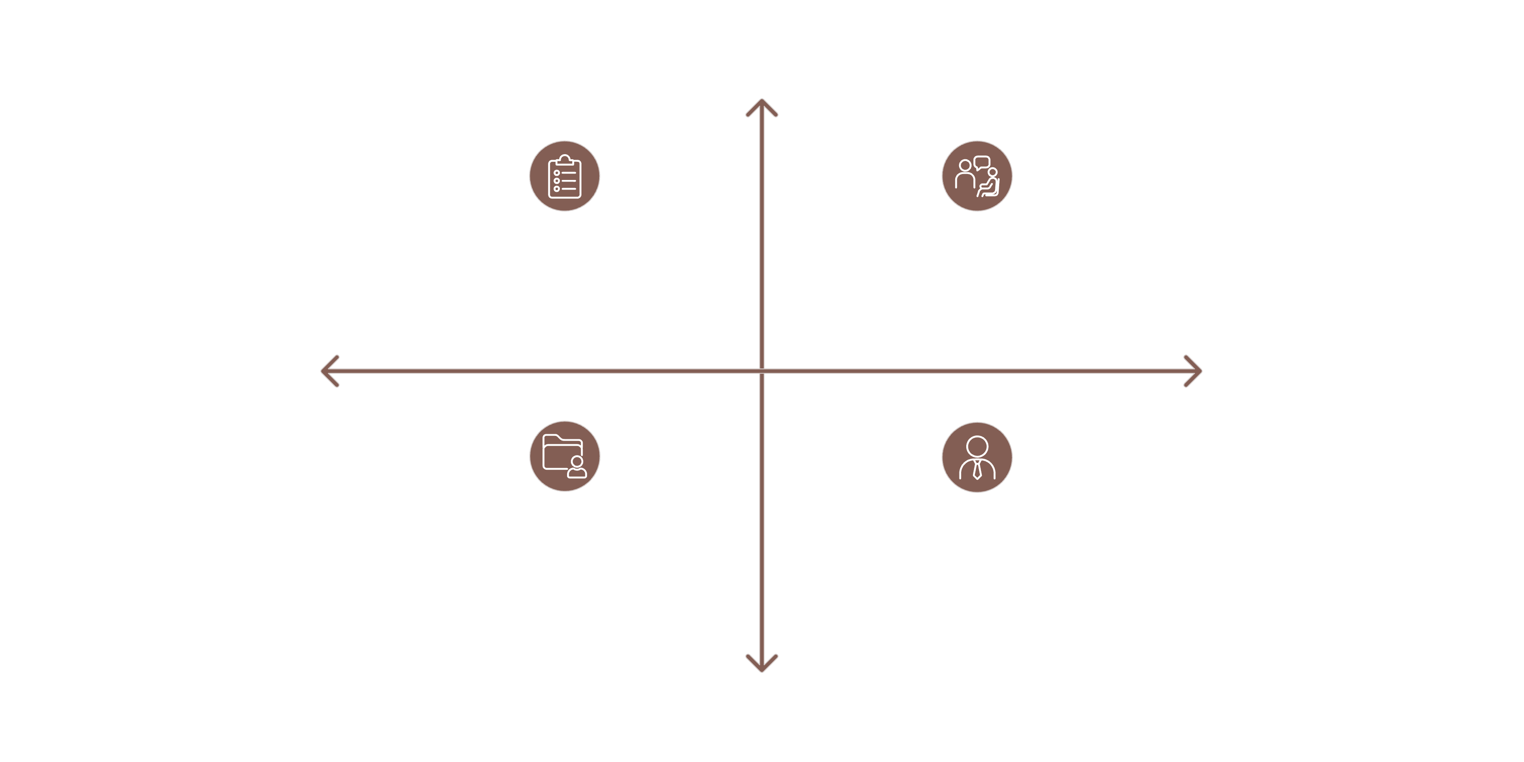
Competitor Landscape: Filling the Critical Gap
Existing solutions fail to address the core need of students: conversational, personalized guidance before they commit to expensive decisions.
Student-Focused
FutureYou
Conversational Student Tool
Counselor-Led Static
Tools
Static
Conversational
Administrative Static Platforms
Counselor-Focused Chat Assistants
Counselor-Focused
Naviance: Counselor-focused, static assessment tools | LinkedIn: Job seeker-focused, not career explorer-focused
CareerExplorer: Assessment-driven, often feels like homework | ChatGPT: Provides generic, unvalidated advice lacking proprietary career data.
.
.
.

Slide 11

The World FutureYou Is Building
Democratizing Career Guidance
Affordable, accessible, built for every student — not just the privileged few
Transforming Career Discovery
Personalized at scale, revealing hundreds of real-world careers students never knew existed
Human-Centered Personalization
Clear, relatable, action-driven — turning stress into step-by-step progress
Social Catalyst
Connecting learners with mentors who've been there before, building community and support
Because the future shouldn't feel uncertain — it should feel Yours.

